Slide 1
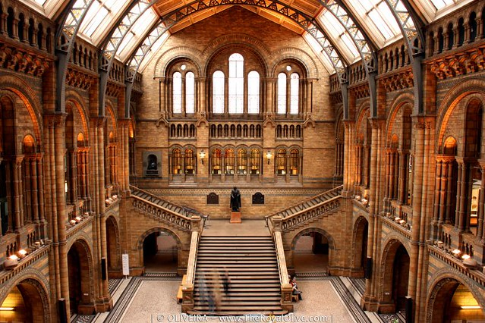
Allied Victory in World War II
Virtual Museum
Room 3
This Photo by Unknown Author is licensed under CC BY-NC-ND
Room 4
Room 2
Room 1
Room 5

Slide 2


Room 1
Turning points of 1945
Select TWO events which led to Allied victory over Germany and explain their significance.
Select TWO events which led to Allied victory over Japan and explain their significance.
Exhibit #1
World War II
Timeline Experience
Return to Museum Lobby
This Photo by Unknown Author is licensed under CC BY-NC

Slide 3


Room 2 British Homefront
How was propaganda used as a total war strategy?
Exhibit #2 National Archives of the United Kingdom
Return to Museum Lobby

Slide 4


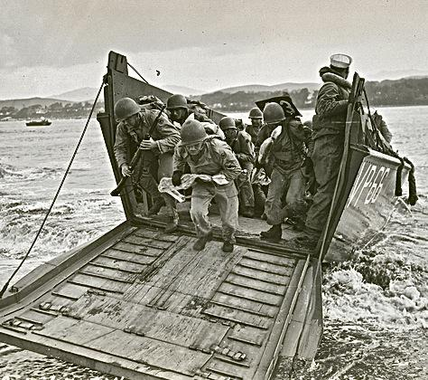
Room 3 D-Day Invasion
What obstacles did the Allies face during the D-Day invasion in June 1944?
Was the invasion successful? Why?
Exhibit #3 The landings at Normandy
Return to Museum Lobby

Slide 5


Room 4 German Surrender
Why were German citizens in shock over Germany’s surrender?
Which date is celebrated at VE Day (Victory in Europe)?
Exhibit #4
German Surrender
Return to Museum Lobby
This Photo by Unknown Author is licensed under CC BY-NC

Slide 6


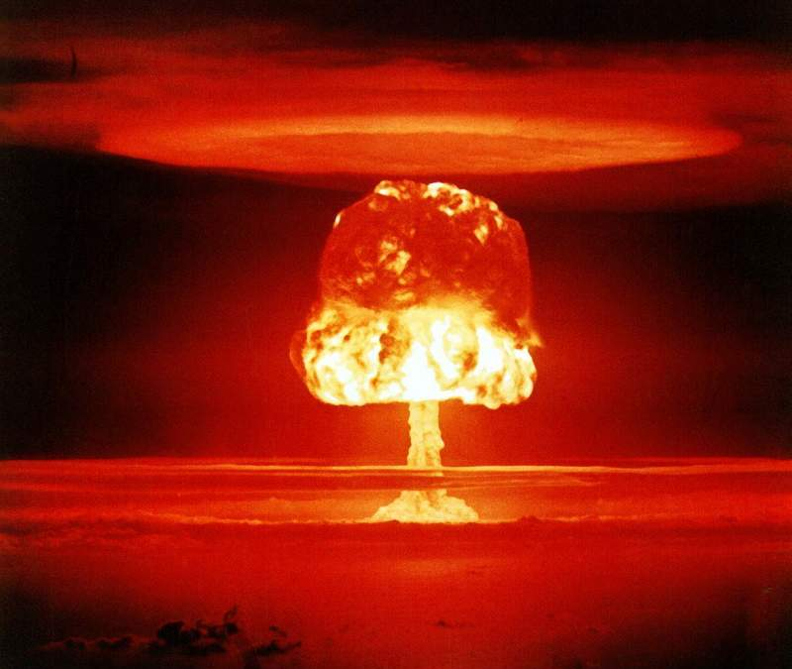
Room 5 Atomic Bomb
Exhibit 5: Remembering Hiroshima and Nagasaki
Exhibit 6:
A-Bomb Drawings from Survivors
Exhibit 7:
Survivors Video #1
Exhibit 8: Harry Truman Library – Decision to Drop the Bomb
Exhibit 9:
Survivors Video #2
How might you define short-term and long-term outcomes of the nuclear bombings in Japan?
Return to Museum Lobby

